Slide 1
Exploring the NYC Airbnb dataset
Bhavana, Drishti and Sashwat

Slide 2
Overview
Preprocessing
Analysis
Exploration
Cleaning
Normalization
Visualisations
Variable correlations
Hypothesis testing

Slide 3
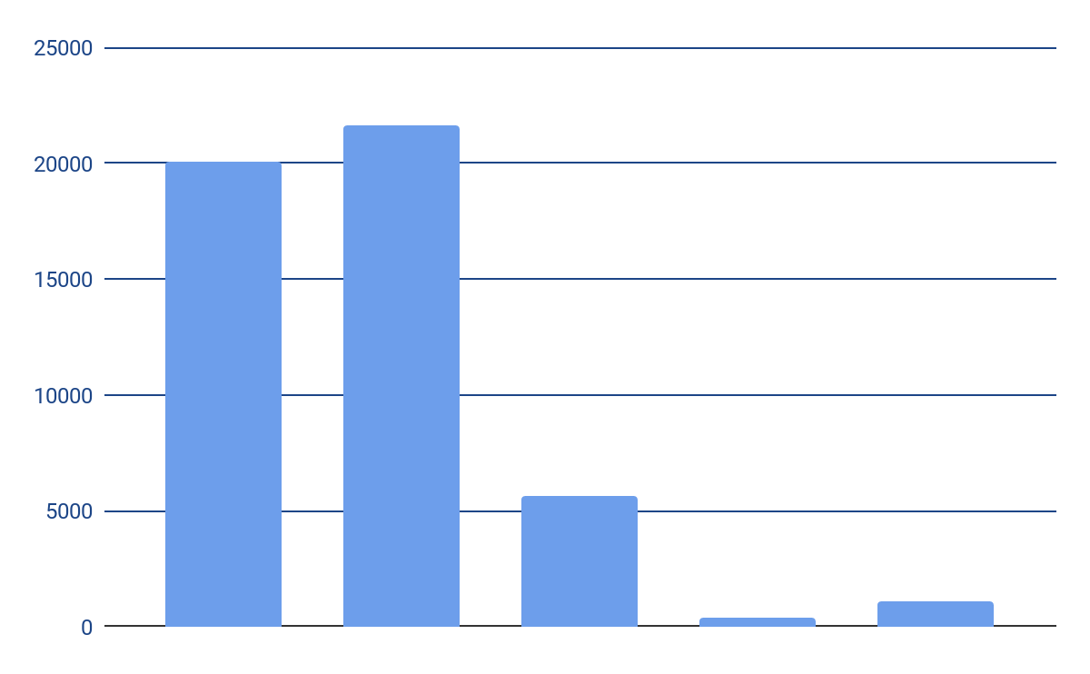
Preprocessing
Dropping redundant attributes
Scaling and mapping
Filling in missing values

Slide 4
Dropping redundant attributes
Numerical attributes
host_id
latitude
longitude
price
minimum_nights
number_of_reviews
last_review
reviews_per_month
calculated_host_listings_count
availability_365
Categorical attributes
name (dropped)
host_name (dropped)
neighbourhood_group
neighbourhood
room_type

Slide 5
Filling in missing values
reviews_per_month: it is assumed that if this field and the last_review field are both empty, then the Airbnb in question has never been reviewed - all missing values were replaced by zeroes.
last_review: all missing values were replaced by zeroes, to indicate that the Airbnb in question has never been reviewed.
minimum_nights: the mean value of all data points was taken based on their room_type values, and appropriately used to fill in missing values.
neighbourhood: the mean latitude and longitude of each neighbourhood was calculated, and the missing neighbourhood attribute values were replaced with the neighbourhoods associated with the closest mean latitude and longitude - 89.43% accuracy when used on entirety of dataset.

Slide 6
Analysis
Visualisations
Variable correlations
Hypothesis testing

Slide 7
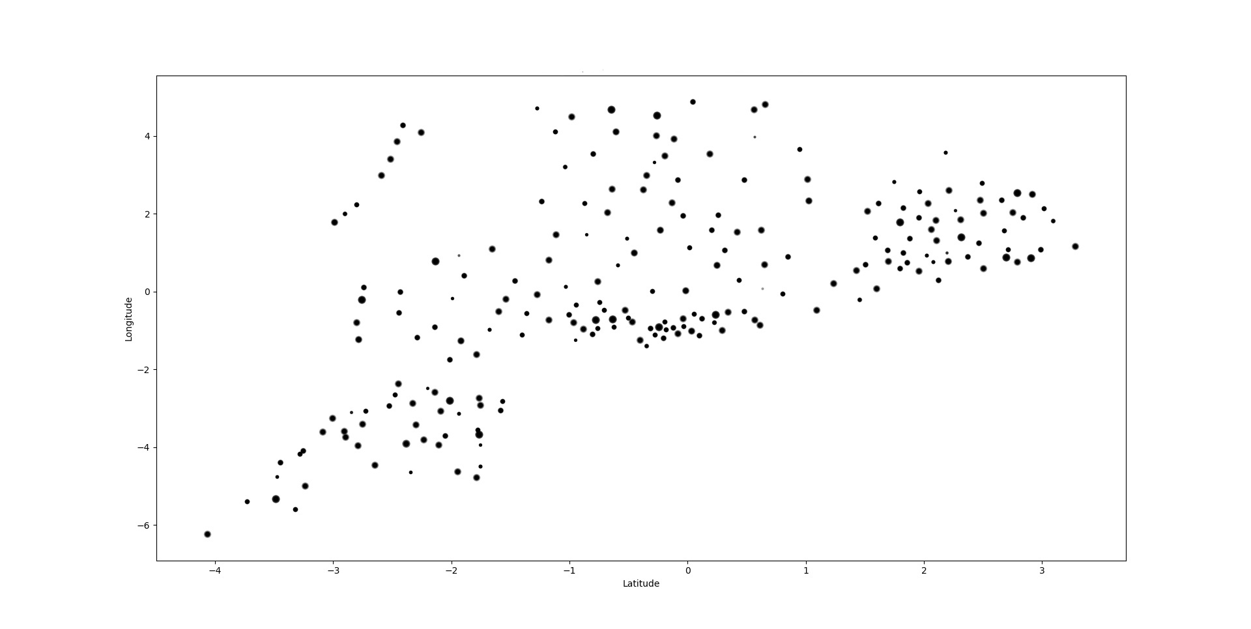
Visualisations
Scatter plot shows the mean rentals of AirBnBs in each neighbourhood.
Each point is located according to the mean location of AirBnBs in that neighbourhood.

Slide 8
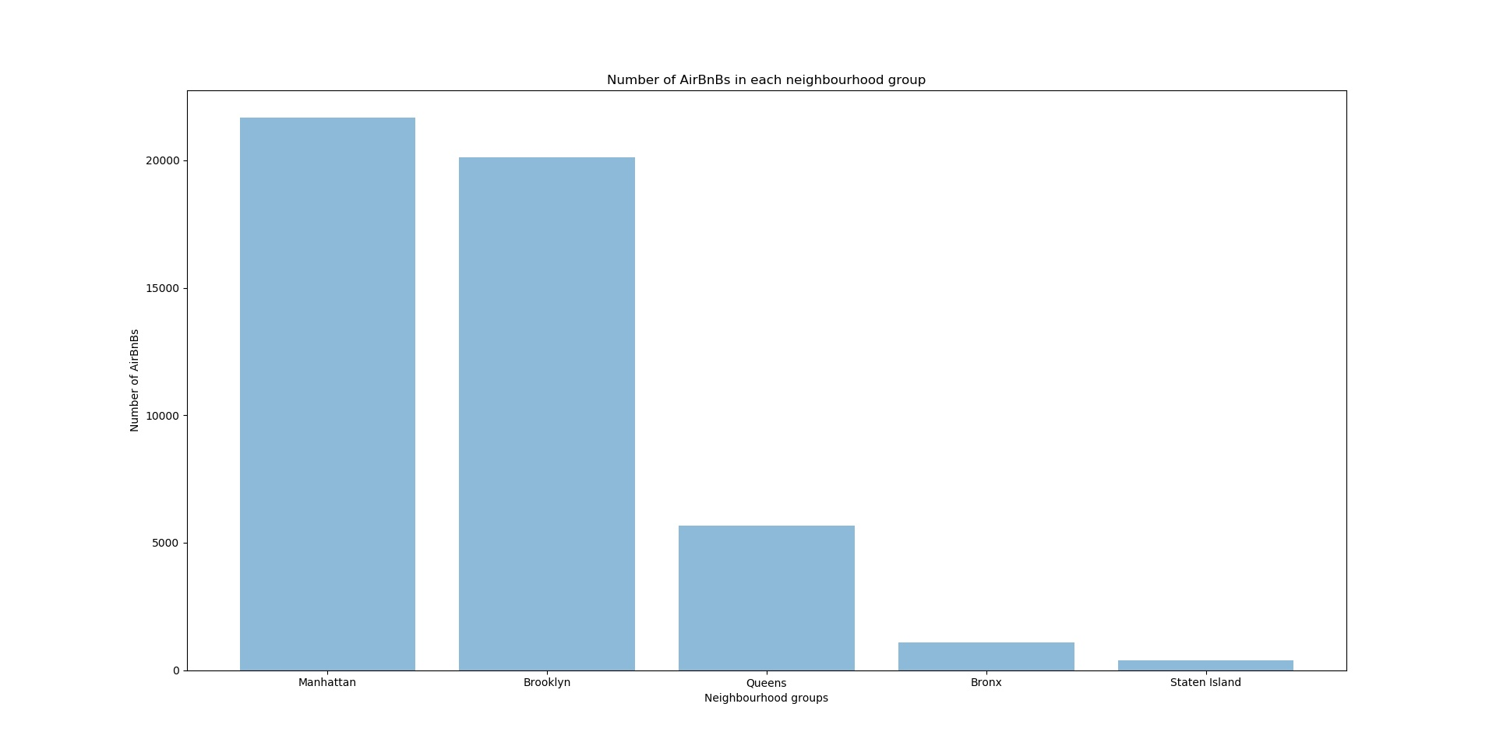
Visualisations
Manhattan and Brooklyn have the most number of AirBnBs.
Bronx and Staten Island have the least number of AirBnBs.

Slide 9
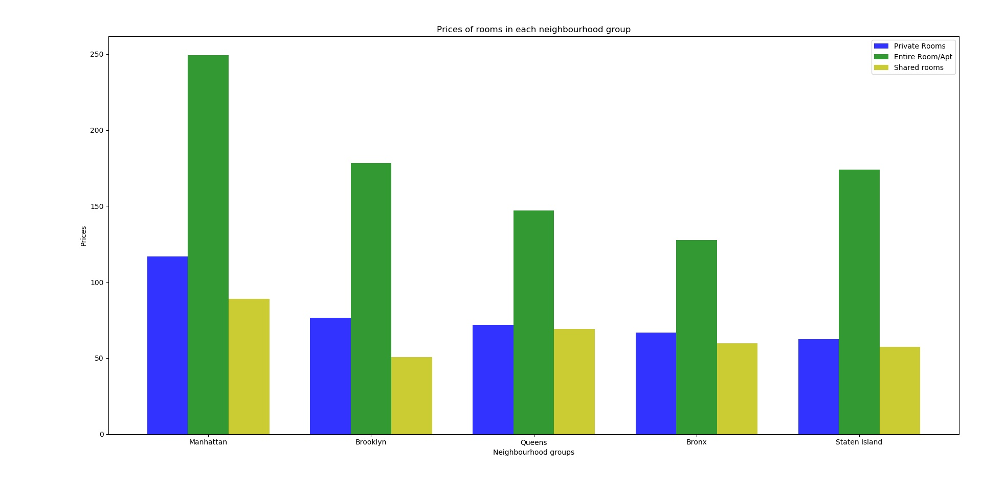
Visualisations
Private rooms , entire rooms/apartments and shared rooms are most expensive in Manhattan.
Shared rooms are the cheapest in Brooklyn.

Slide 10
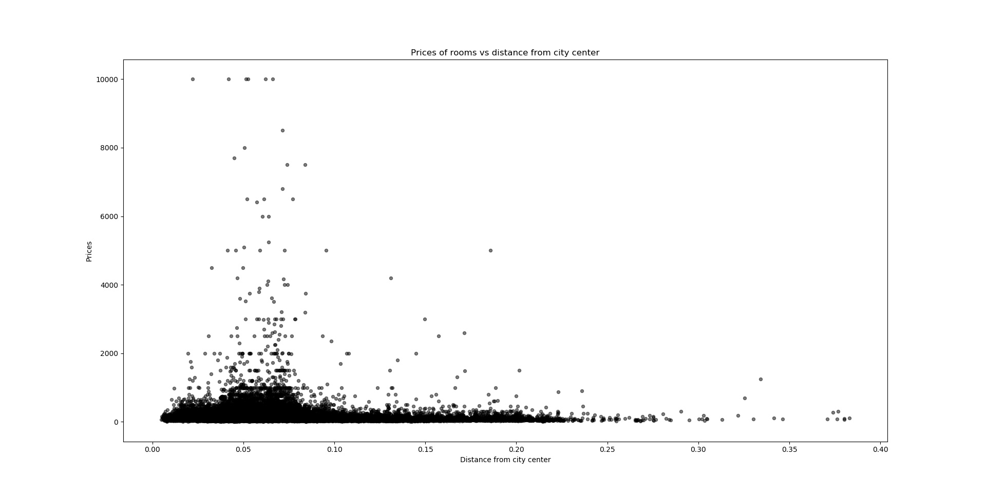
Visualisations
Prices of AirBnBs reduce with increase in distance from the city center.

Slide 11
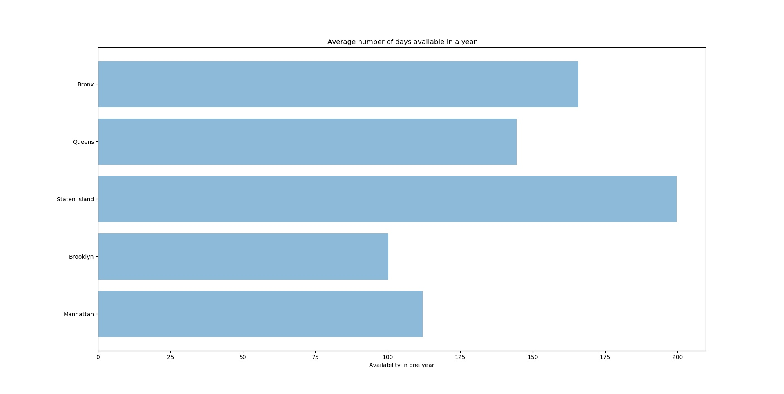
Visualisations
Staten Island is available for the most number of days in a year.
Availability of AirBnBs in Brooklyn is the least.

Slide 12
Hypothesis
1. H0: Manhattan is not the most expensive part of the city
H1: Manhattan is the most expensive part of the city
The Null hypothesis is rejected based on the graph
2. H0: The price of AirBnBs is unrelated to the location
H1: The price of the AirBnBs closer to the city center is higher
The Null hypothesis is rejected based on the graph
3. H0: Brooklyn is not the busiest part when it comes to availability of AirBnBs
H1: Brooklyn is the busiest part when it comes to availability of AirBnBs
The Null hypothesis is rejected based on the graph
4. H0: Bronx does not have the lowest number of AirBnBs
H1: Bronx has the lowest number of AirBnBs
The Null hypothesis is rejected based on the graph

Slide 13
Hypothesis
1. H0: Mean price in Manhattan is 196
H1: Mean price in Manhattan is not 196
p = 0.6582208776133793
Accept null hypothesis
2. H0: AirBnBs are available in Brooklyn for an average of more than 150 days out of 365
H1: AirBnBs are available in Brooklyn for an average of less than 150 days out of 365
Reject null hypothesis

Slide 14
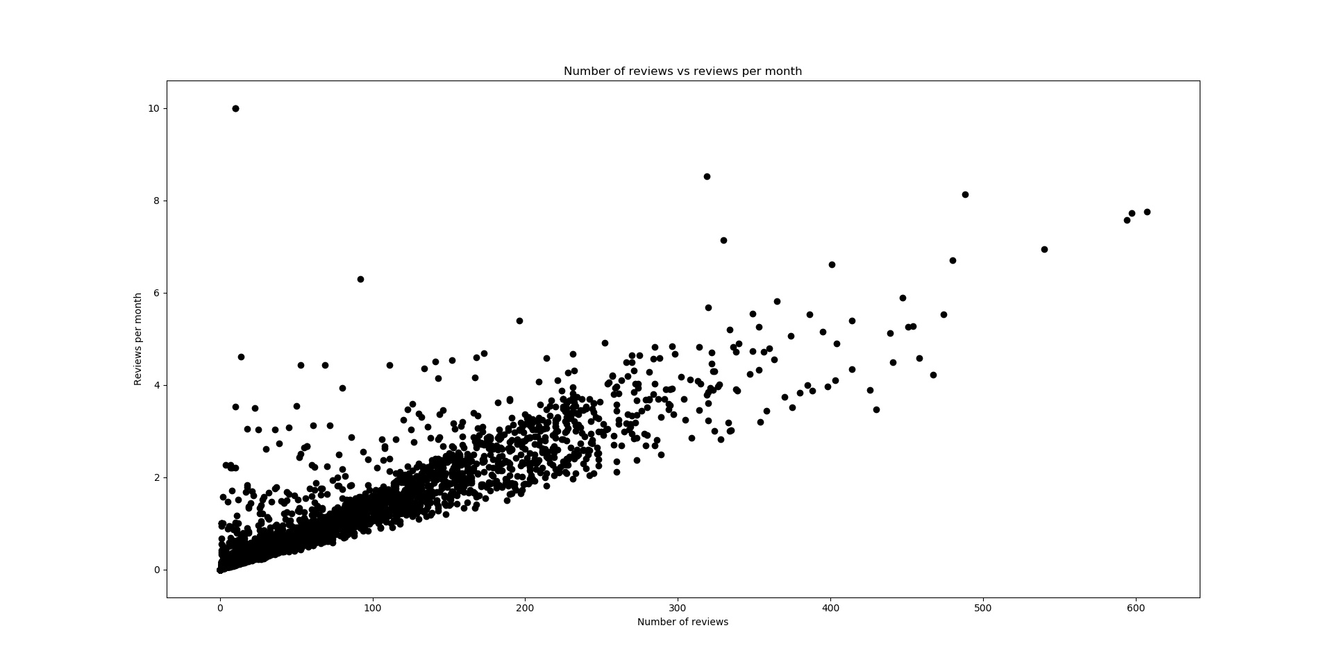
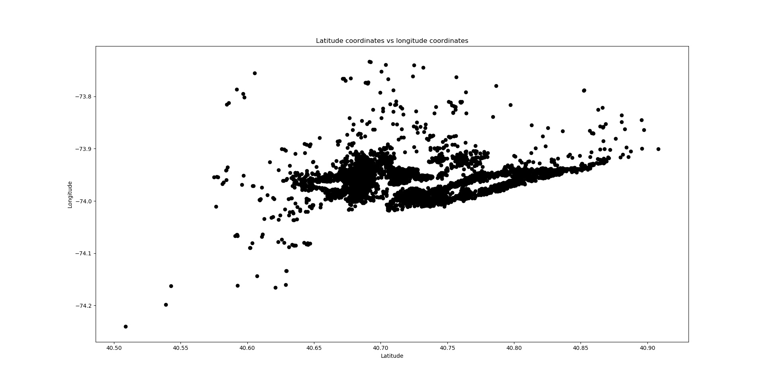
Correlation
Correlation between number of reviews and reviews per month.
Correlation coefficient: 0.589
The correlation is notable and is positive.
Correlation between latitude and longitude coordinates.
Correlation coefficient: 0.085
The correlation is not notable.

Slide 15
Thank you.

